Slide 1
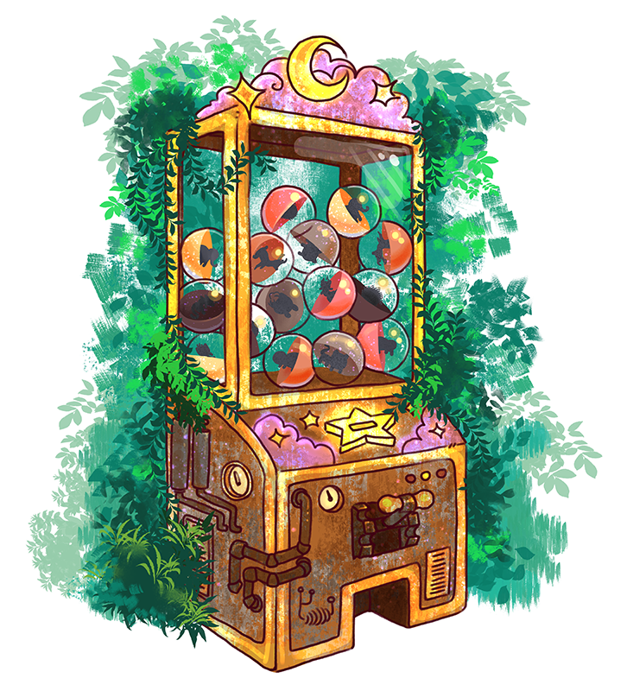
Gacha Collection Beckend
290AA – Advanced Software Engineering
Group: Ardizzoni Francesco Del Castello Diego Prestifilippo Colombrino Mattia Tortorelli Felice

Slide 2

User
ID
First Name
Last Name
E-mail
Password (hash)
History
Currency Amount

Slide 3



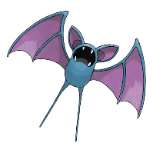



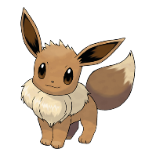
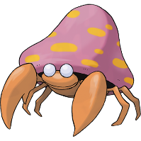

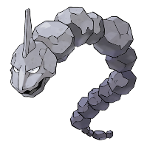

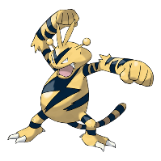
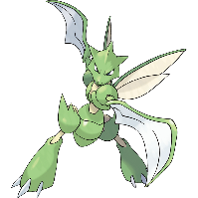
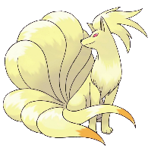


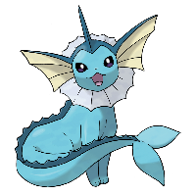


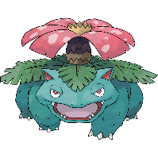
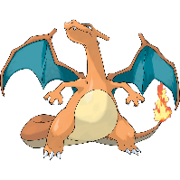

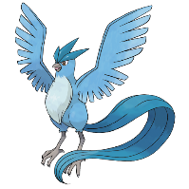

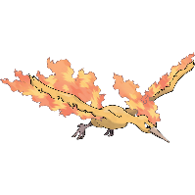

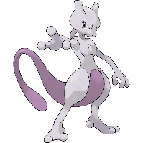
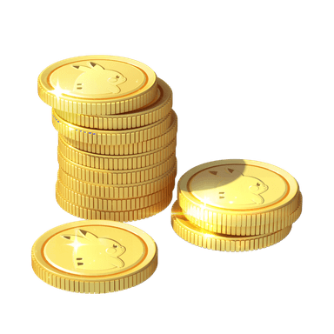

Catalogue – All 151 Pokémon from 1° gen
Common (54,45%)
Uncommon (40%)
Rare (5%)
Epic (0,5%)
Legendary (0,05%)
In-game currency: Pokedollars

Slide 4
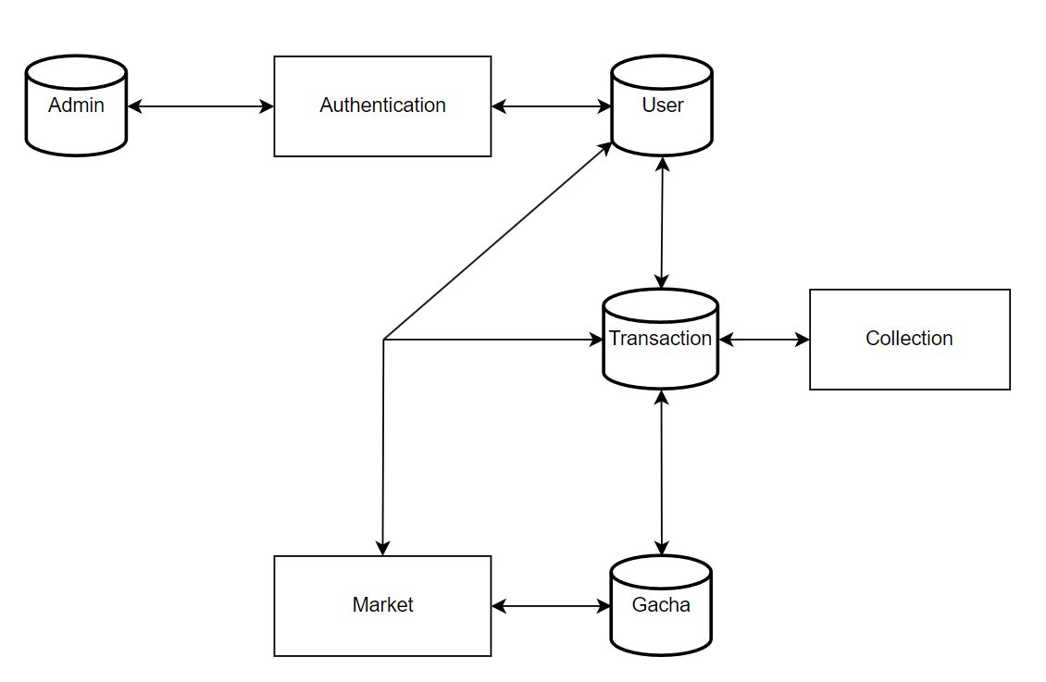
The Architecture

Slide 5
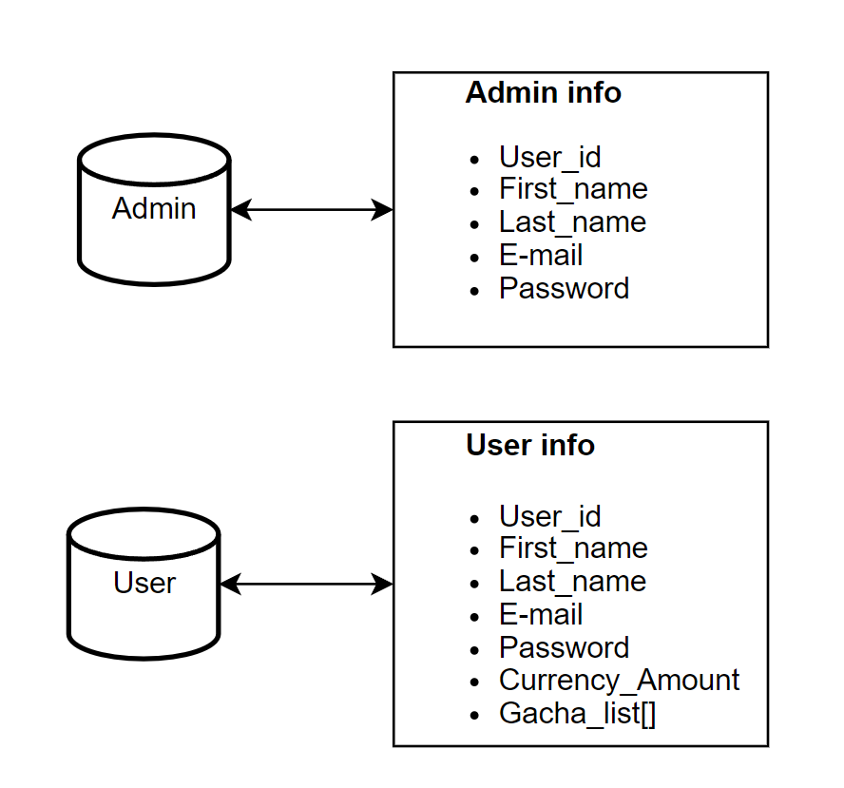
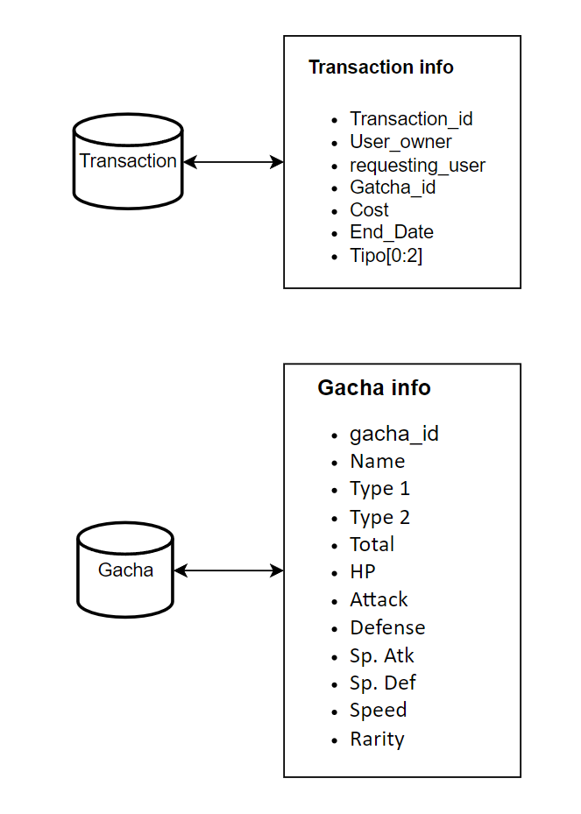
The Architecture

Slide 6
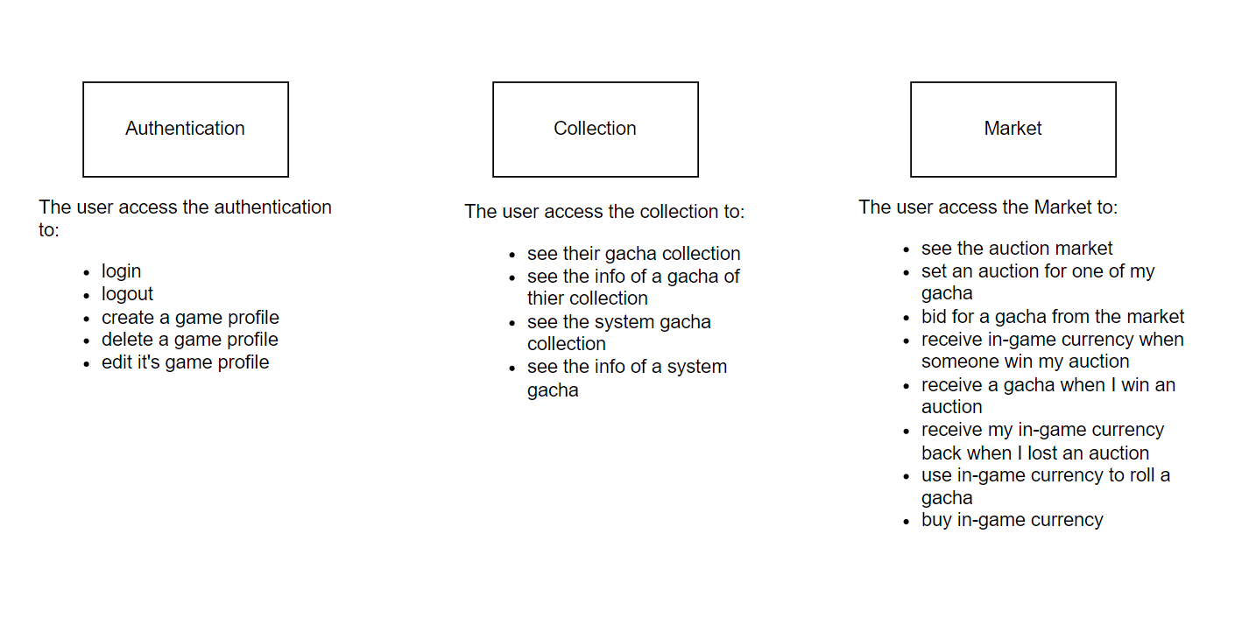
The Architecture

Slide 7
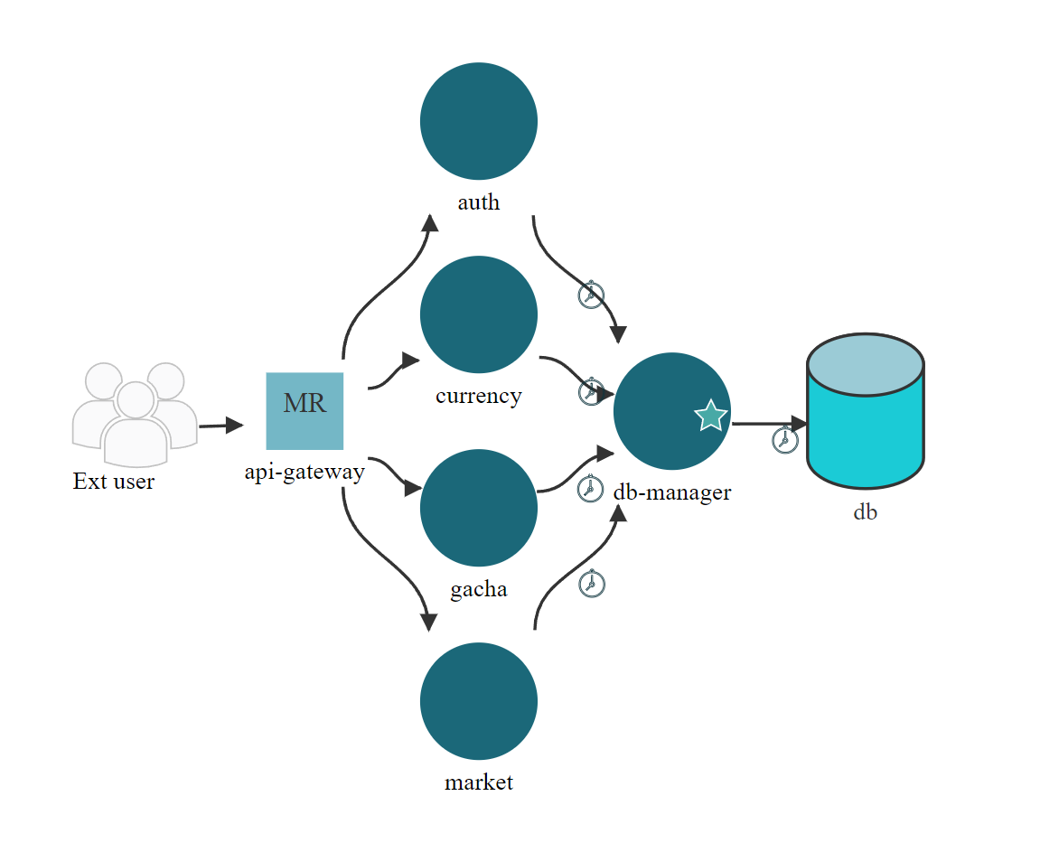
Microfreshener

Slide 8
The micro-services
-api-gateway This API Gateway acts as the main entry point for client requests, forwarding them to the appropriate microservices for processing. It integrates with multiple services.
-db-manager
This API is part of a microservices architecture and handles all the queries to the database.
-auth-service This API is part of a microservices architecture and serves as the user management service for the application. It provides operations such as register a new user or authenticate a user
-currency-service
This API is part of a microservices architecture and serves as the currency management service for the application. It provides operations for managing in-game currency and rolling gacha items.
-gacha-service
This API is part of a microservices architecture and serves as the gacha management service for the application. It provides operations for managing gachas and retrieving gacha infos.
-market-service
This API is part of a microservices architecture and handles transactions related to gacha itemsand user purchases. It interacts with other services to track and update user transactions.

